Slide 1
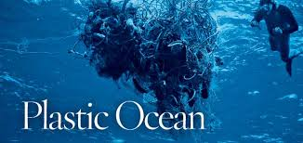
Pacific Mess.
Understanding and learning the brutal effects of pollution and nuclear spills.

Slide 2
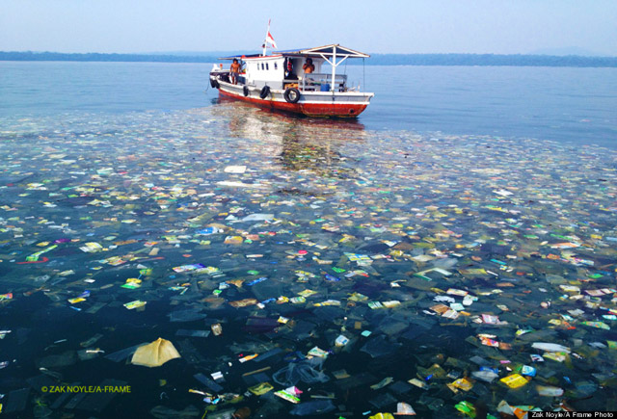
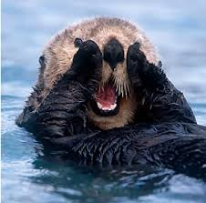
Facing the Problem.
Well first off, I would like to start to address the problem. THE OCEANS DYING GUYS! It didn’t happen overnight, and it’s not because of the billions of years it holds under it’s belt.

Slide 3
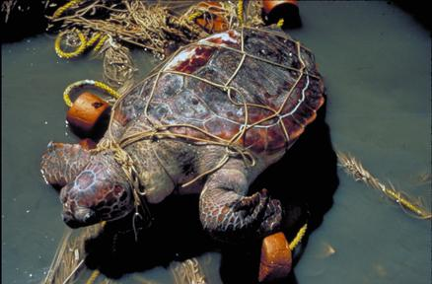
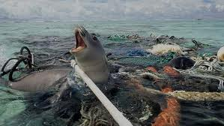
Facing the Problem.
Humans don’t help the problem. We take advantage of our lifestyles, we are conquering the world not trying to live hand and hand with it. We pollute. Pollution is one of the biggest deals. our animals, innocent creatures are living and adapting to all the debris and trash in their waters.

Slide 4
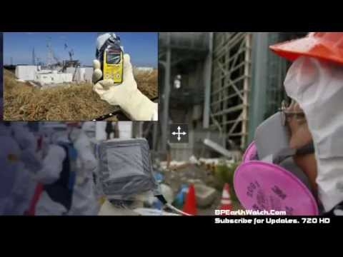
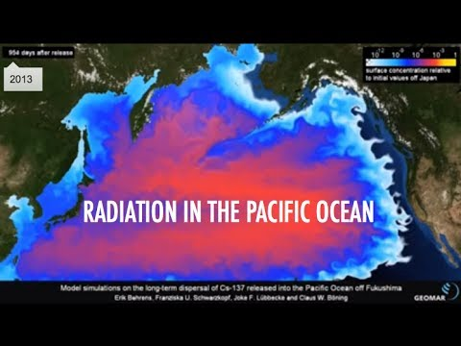
Facing the Problem.
Another main problem is the Fukushima disaster. Four Nuclear units hit by a tsunami caused by an earthquake, right off the coast of japan. This caused nuclear units 1,3, and 4 to explode from hydrogen air explosions. Unit 2 blew up because of water vapor “steam”.

Slide 5
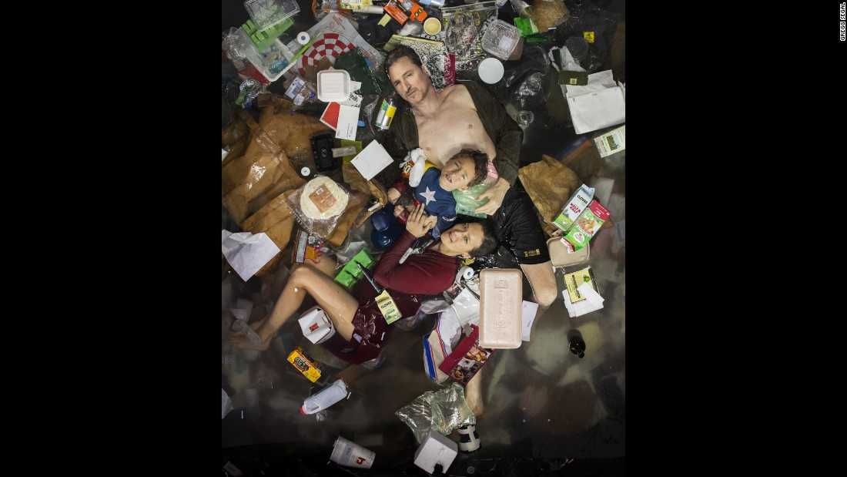
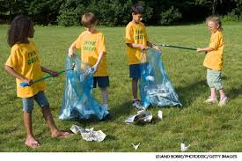
Pollution!
We all produce trash, each and everyone of us, but how we handle it, what we do with it is important.

Slide 6
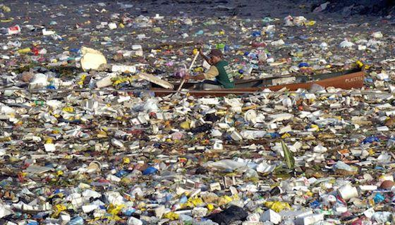
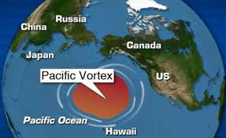
Pollution!
We are losing 1 million or so apex predators because of plastic! The trash mass in the Pacific is the size of Canada NOT Texas. 2.4 million pounds of plastic waste is produced in this world every hour.

Slide 7
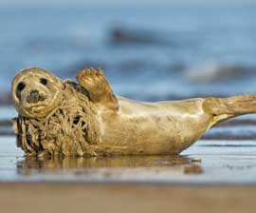
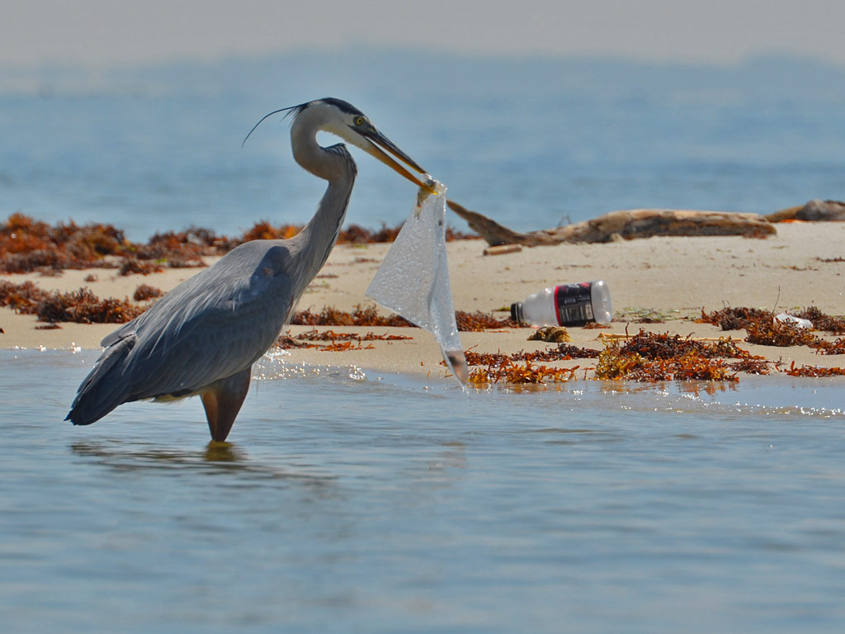
Pollution!
Our animals are in need of clean water, they’re being tangled by trash. They eat it mistaking it for food, killing them slowly because they cannot digest an un-natural substance.

Slide 8
Midway Island, North Pacific.

Slide 9
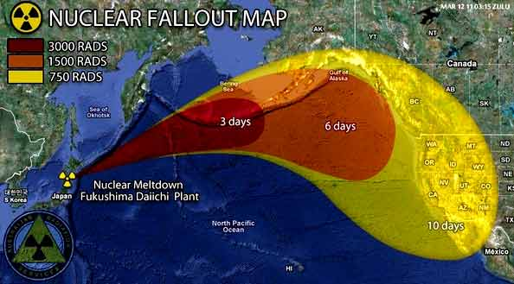
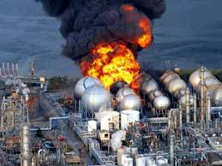
Fukushima!
Fukashima’s chemicals have already leaked into the Pacific causing the currents to spread the radiation.

Slide 10
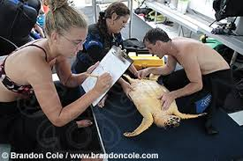
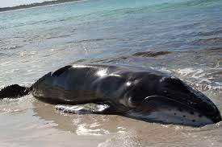
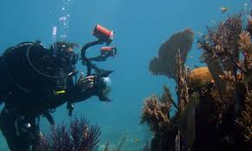
Fukushima!
Marine biologists don’t see animals as much anymore but when they do they look pained.

Slide 11
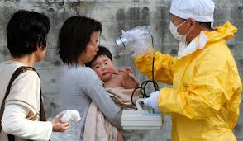
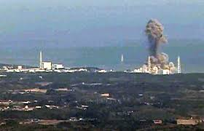
Fukushima!
The leakage from the disaster has many effects on humans as well. Japanese are finding cancer increase in the people living near the spill.

Slide 12
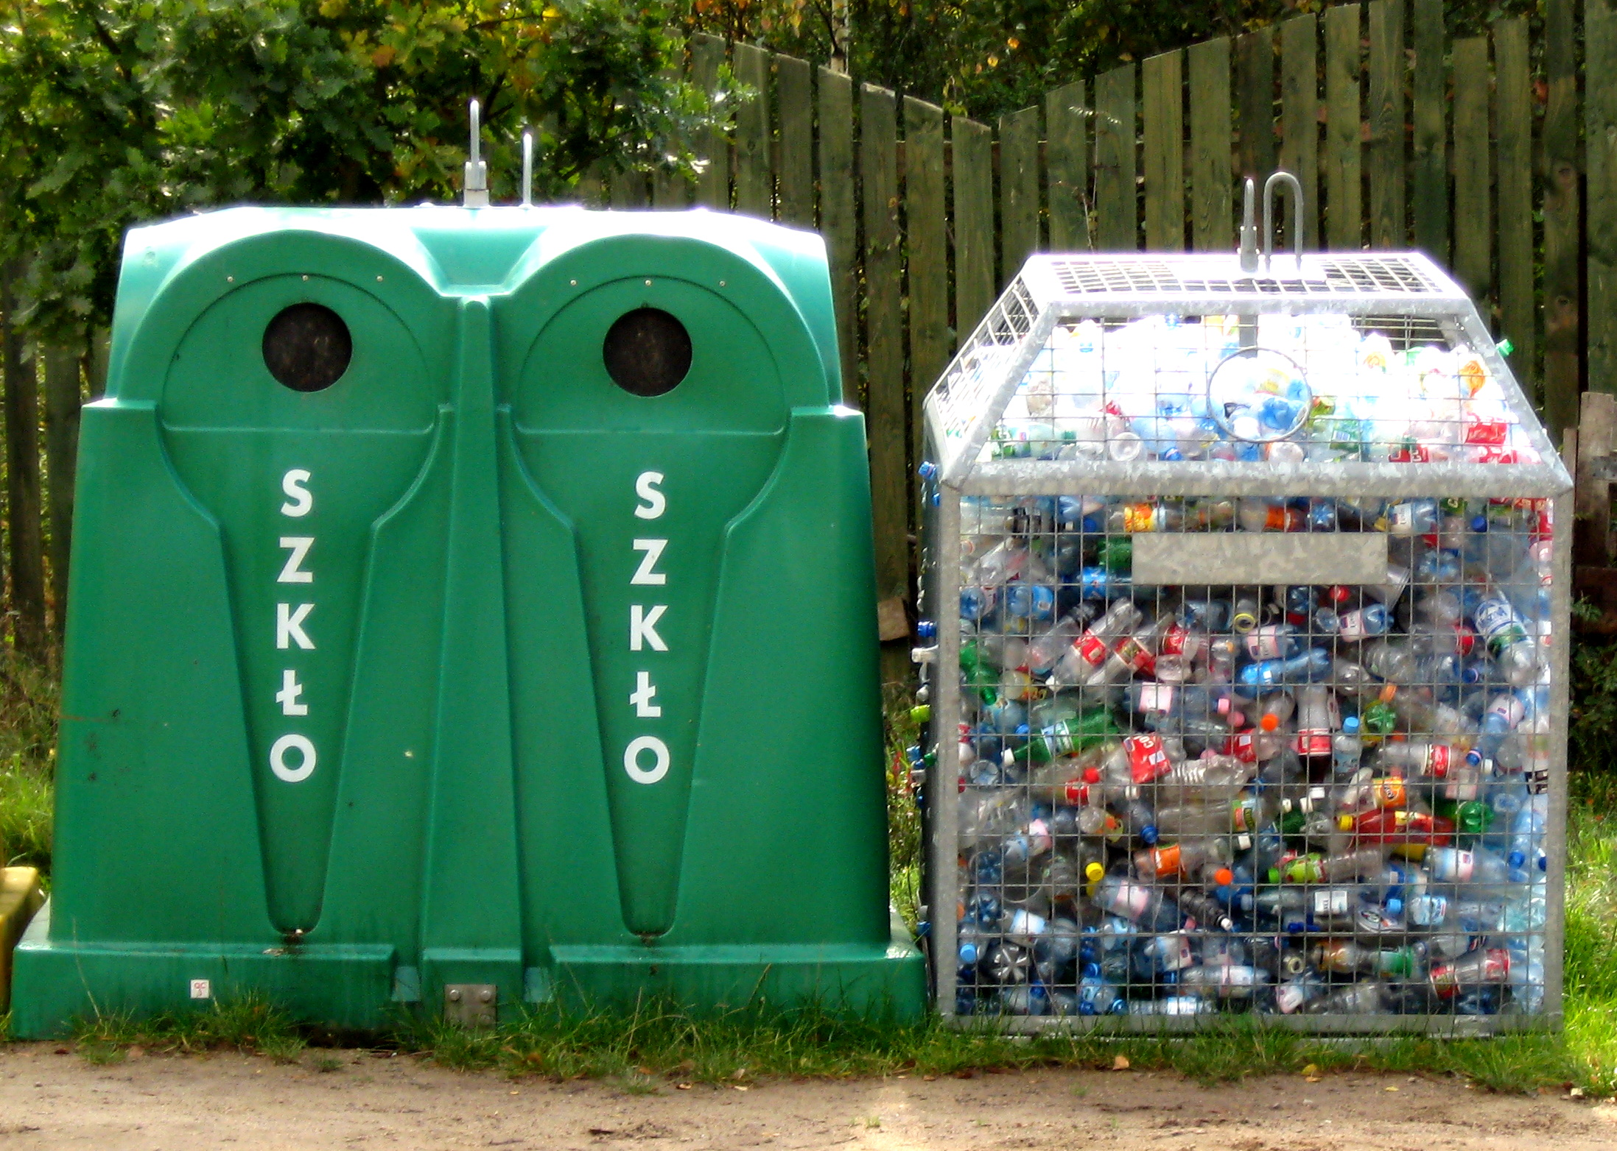
Solutions (:
As these problems progress rapidly, there are some things we can do to help! RECYCLE, RECYCLE, RECYCLE.

Slide 13
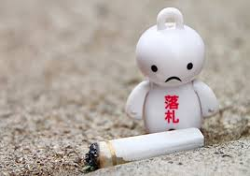
Solutions (:
DO NOT LITTER! This is our home, not the trashes!!

Slide 14
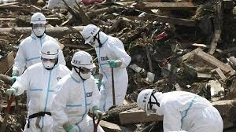
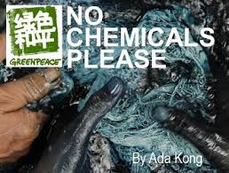
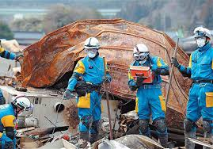
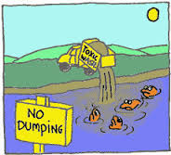
Solutions (:
Fukushima is a hard thing to solve, we can’t un-do a chemical leak, we can only learn from it!

